Slide 1
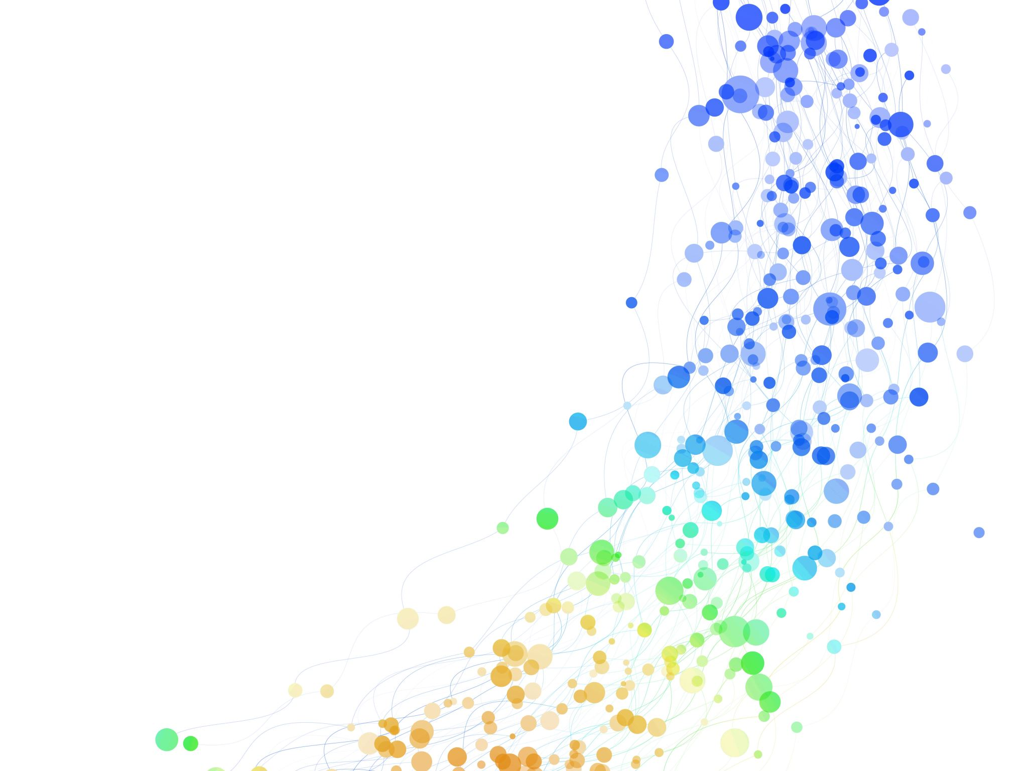
Incremental uplift of promotional offers on sales
Ali Rafiee
Arafieep@uwaterloo.ca

Slide 2
Introduction
Promotional offers are a powerful tool that retailers can use to increase sales and attract new customers
There are many different types of promotional offers, including discounts, buy one get one free (BOGO) offers, free gifts, and more.
Each type of promotional offer has its own strengths and weaknesses, and retailers need to carefully consider which type of offer will be most effective for their business.

Slide 3
Objectives
In this presentation, we will be focusing on two of the most popular types of promotional offers: discount offers and BOGO offers.
Our goal is to determine which of these two types of offers is more effective at increasing sales for our Canadian retailer.
To do this, we will be analyzing a dataset that contains information on customer behavior, including their past purchases and whether they have previously used discount or BOGO offers.
Our analysis will help us identify which type of promotional offer provides the greatest incremental uplift in sales, and we will provide recommendations for the retailer based on our findings

Slide 4
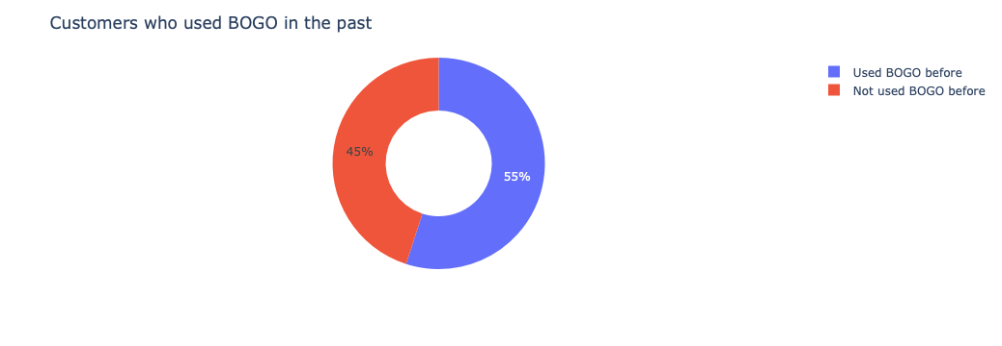
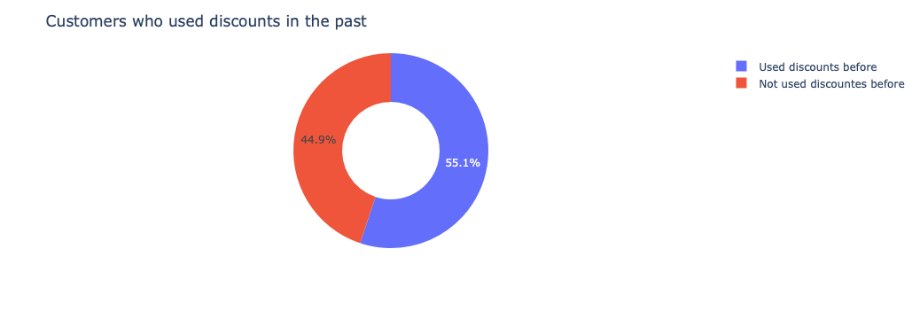
Data understanding
There are 64,000 customers in the dataset, and the promotional campaigns were aimed at increasing sales of a specific product category
Percentage of customers using both promotions in the past: 10.07%
Percentage of customers using at least one of the promotions in the past: 100%

Slide 5
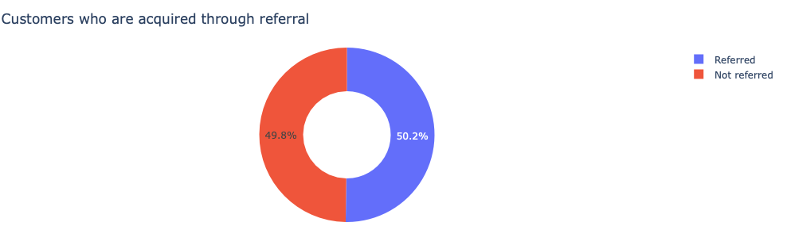
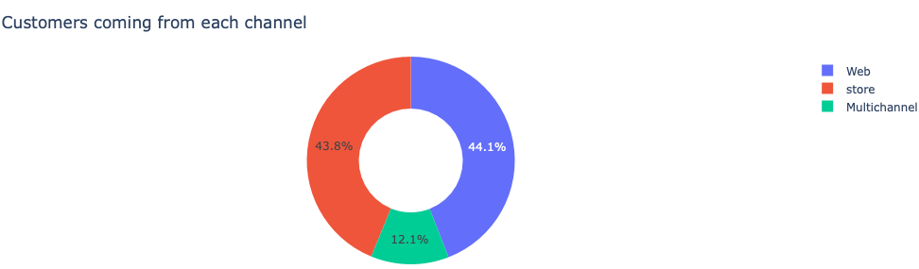
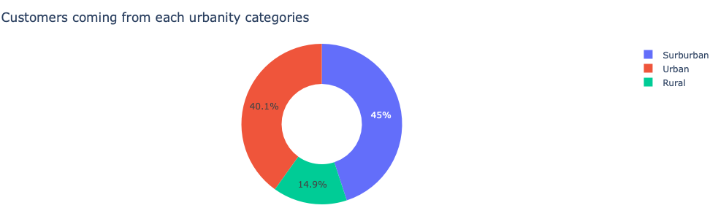
Data understanding
Almost (50%) of our customers are acquired through referrals
The majority of our customers (87.9%) come from two channels "Web", and "Store", and the rest come from "Multichannel" means.
The majority of our customers (85.6%) come from two urbanity categories "Suburban", and "Urban", and the rest come from "Rural" areas.

Slide 6
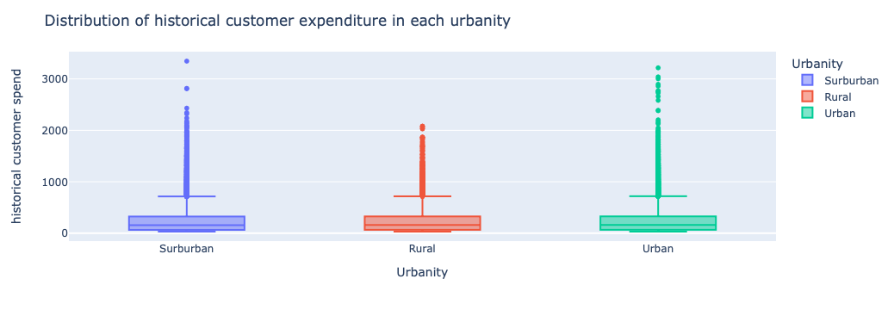
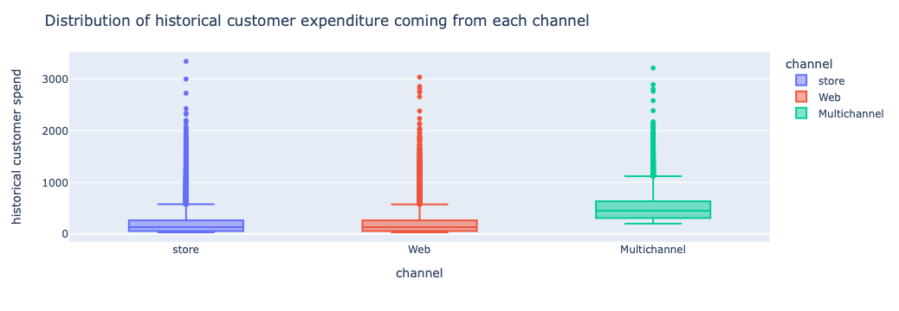
Data Understanding

Slide 7
Approach
Calculating Incremental Uplift:
We used a formula called the incremental uplift formula to figure out the impact of our promotional offers on sales.
The formula is simple: we subtracted the conversion rate of the control group from the conversion rate of the treatment group, then divided by the conversion rate of the control group.
This allowed us to see how much additional sales we got from the promotional offer compared to if we didn't have any promotion at all.
To get the treatment and control groups, we randomly assigned customers to either group.
The treatment group received the promotional offer, while the control group did not receive any offer.
By comparing the conversion rates of the two groups, we were able to calculate the incremental uplift of the promotional offer
Finally, our conclusions are statistically tested and verified

Slide 8
Results
We provide the results of our analysis through answering a series of questions:
Disregarding all features of our customers, which promotion is more effective?
Is a promotion more effective if a customer has historically used it before?
Is a promotion more effective if a customer is acquired through referral?
Is a promotion more effective if we target customers with higher or lower recency?

Slide 9
Disregarding all features
Based on the analysis, the discount offer has a higher conversion rate and incremental uplift compared to the BOGO offer. The discount offer had a conversion rate of 0.18 and an uplift of 0.07, while the BOGO offer had a conversion rate of 0.15 and an uplift of 0.04. This suggests that the retailer should focus on offering discount promotions rather than BOGO promotions to increase sales.
It's important to note that the analysis only considers the overall conversion rate and uplift, and it may be beneficial to further investigate the effectiveness of each offer on different customer segments or in different contexts. Additionally, conducting A/B testing and exploring other promotional strategies may provide further insights and opportunities for optimizing sales.
Offer | Conversion Rate | Uplift
BOGO | 0.15 | 0.04
Discount | 0.18 | 0.07

Slide 10
Is a promotion more effective if a customer has historically used it before?
Customers who used BOGO before but no other promotion:
Based on the results for customers who have used BOGO but no other promotions, the BOGO offer has a higher conversion rate and uplift compared to the discount offer. The conversion rate for the BOGO offer is 0.1698, while the conversion rate for the discount offer is 0.1664. The uplift for the BOGO offer is 0.074, while the uplift for the discount offer is 0.071. Therefore, it may be more effective to target these customers with the BOGO offer rather than the discount offer.
Offer | Conversion Rate | Uplift
BOGO | 0.169 | 0.073
Discount | 0.166 | 0.07

Slide 11
Customers who used Discount before but no other promotion:
For customers who have historically only used discount offers, the analysis shows that offering a discount promotion to these customers would result in a higher conversion rate and uplift compared to offering a BOGO promotion. Specifically, the conversion rate for the discount offer is 0.168968, while the conversion rate for the BOGO offer is 0.110892. The uplift for the discount offer is 0.069155, while the uplift for the BOGO offer is 0.011078.
Customers who used both promotions before:
The results show that customers who have used both BOGO and Discount promotions in the past are more likely to convert with the Discount promotion. The conversion rate for Discount promotion is 31.5%, which is higher than the conversion rate for BOGO promotion which is 25.2%. The uplift for Discount promotion is also higher at 13.4% compared to BOGO promotion which has an uplift of 7.1%. Therefore, it is recommended to target these customers with the Discount promotion in the future.
Offer | Conversion Rate | Uplift
BOGO | 0.11 | 0.01
Discount | 0.16 | 0.06
Offer | Conversion Rate | Uplift
BOGO | 0.25 | 0.07
Discount | 0.31 | 0.13

Slide 12
Is a promotion more effective if a customer is acquired through referral?
The results indicate that no matter whether a customer is acquired though referral or not, still a Discount promotion is more likely to convert the customers.
Offer | Conversion Rate | Uplift
BOGO | 0.12 | 0.05
Discount | 0.15 | 0.07
Referred
Offer | Conversion Rate | Uplift
BOGO | 0.17 | 0.04
Discount | 0.21 | 0.07
Not referred

Slide 13
Is a promotion more effective if we target customers with higher or lower recency?
Our results show through statistical tests that no matter how the recency looks like, still discount promotion provide more conversion rates and uplifts.
Offer | Conversion Rate | Uplift
BOGO | 0.16 | 0.04
Discount | 0.20 | 0.08
Higher recency
Offer | Conversion Rate | Uplift
BOGO | 0.12 | 0.04
Discount | 0.15 | 0.07
Lower recency

Slide 14
Interpretation and summary
If we disregard historical features of our customers discount promotions provide a 7% uplift and a conversion rate of 18%, higher than BOGO.
For customers who have only used BOGO in the past, BOGO provides a 7.3% uplift and 17% conversion rate, higher than discount promotions.
For customers who have only used Discount in the past, Discount provides a 6% uplift and 16% conversion rate, higher than BOGO promotions.
For customers who have used both promotions in the past, Discount provides a 13% uplift and 31% conversion rate, higher than BOGO promotions.
For customers who are acquired through referral, Discount provides a 7% uplift and 15% conversion rate, higher than BOGO promotions. Similarly for customer that are not acquired through referral Discount provides a 7% uplift and 21% conversion rate, higher than BOGO promotions.
For customers with their last purchase within last 6 months Discount promotions has 20% conversion rate, and 8% uplift, while for customers with their last purchase greater than 6 months from now conversion rate is 15% and 7% uplift.

